Slide 1
Python Regex
Purdue University

Slide 2

What is Regex?
Regular Expressions are expressions that are used for pattern matching in text. Regex has a variety of uses including:
Extracting key information from text
Validating user input
Reformatting text

Slide 3
Basic Syntax
Suppose we have an example string “acme”
acme :matches any text containing “acme”
^acme :matches any text that begins with “acme”
acme$ :matches any text that ends with “acme”
^acme$ :matches if the entire text is equal to “acme”
acme* :matches any string that contains “acm” followed zero or more “e”
acme+ :matches any string that contains “acm” followed one or more “e”
acme? :matches any string that contains “acm” followed one or one “e”
acme{2} :matches any string that contains “acm” followed by 2 “e”
acme{2,} :matches any string that contains “acm” followed by 2 or more “e”
acme{2,5} :matches any string that contains “acm” followed by 2 to 5 “e”
Escape special characters with backslash (e.g. \+)

Slide 4
Character sets []
Character sets [] allow you to specify a character set or range of characters to match against.
[a-z] :match any lowercase letters from a to z
[A-Z] :match any uppercase letters from A to Z
[0-9] :match any lowercase numbers from 0-9
^ :matches anything not in the set (i.e. [^0-9] matches anything that’s not a number)
You can chain multiple sets together to broaden your search
[a-z0-9] matches any lowercase number or letter

Slide 5
Capturing Group ()
A capturing group () creates a substring to match against and allows you to chain multiple regular expressions together.
Matches one lower case number or number followed by three upper case letters
([a-z0-9]){1}([A-Z]){3}
The pipe character acts as an “or” operator. This matches a letter a or b
(a|b)

Slide 6
Character Classes
Character classes allow you to match text based on character type
\d :matches any decimal point
\w :matches any word (letter or number)
\s :matches whitespace character
\D :matches a single non-digit character
. :matches any character

Slide 7
Flags
Flags allow regular expressions to be processed with different options:
/<regular expression/<flag>
g :short for global. Matches the entire string. Finds all matches rather than one
m :^ or $ will match each line rather than the entire string
i :makes the regular expression case insensitive

Slide 8
Simple Email Regex
Here us a simple regex that matches against email addresses
/[^@]+@[^\.]+\..+/g
/g
[^@]+ matches one or more character that’s not a @
@[^\.]+ matches one @ character and one more more characters that not a period
\. Matches a single period character
.+ Matches any number of characters

Slide 9
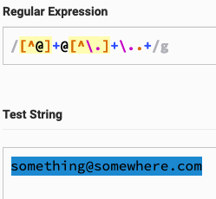

Slide 10
Phone number regex
Here is a simple regex that detects phone numbers
/([(+]*[0-9]+[()+. -]*)/g
([(+]* :Begins a capture group. Detects zero or more “(+” strings
[0-9]+ :Detects one or more numbers
[()+.-]) :Detects zero or more “()+.-” strings.

Slide 11
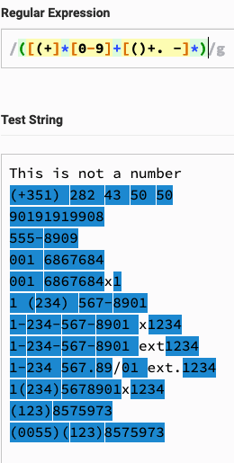

Slide 12
Regex Resources
There is a lot more to the Regex syntax than what is covered in this presentation. Here are some useful resources for writing regular expressions:
https://www.regextester.com/
https://medium.com/factory-mind/regex-tutorial-a-simple-cheatsheet-by-examples-649dc1c3f285
https://regexr.com/
http://www.cbs.dtu.dk/courses/27610/regular-expressions-cheat-sheet-v2.pdf

Slide 13
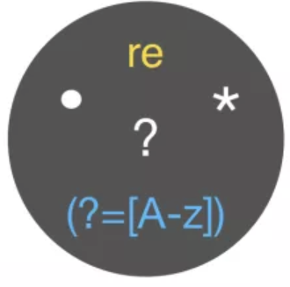
Regex in Python
The re module in Python allows us to handle regex in an easy and object oriented way.
Import the re module
import re

Slide 14
re module
Initiate re object with a regular expression and assign it to a variable
<regex variable> = re.compile(r‘<regular expression>’)
Use the search() function of the <regex variable> to search through your <text> and assign the resulting match object to a <matches> variable. The search() function only returns the first match
<matches> = <regex variable>.search(‘<text>’)
Use the findall()method to return all matches in an array.
<matches> = <regex variable>.findall(‘<text>’)

Slide 15
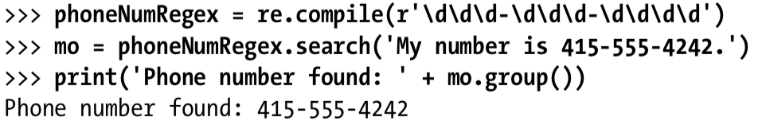

Slide 16
group() and groups()
The Match object’s group() functions can return matched regex capture groups.
<matches>.group() :returns all the matched groups as a string
<matches>.group(<capture group number>) :returns the matches for the capture group specified
<matches>.groups() :returns the matches as an array of strings where each matched group is an array item

Slide 17
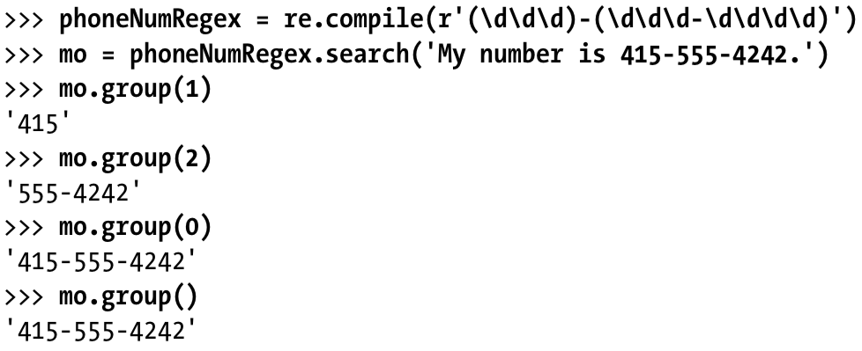


Slide 18
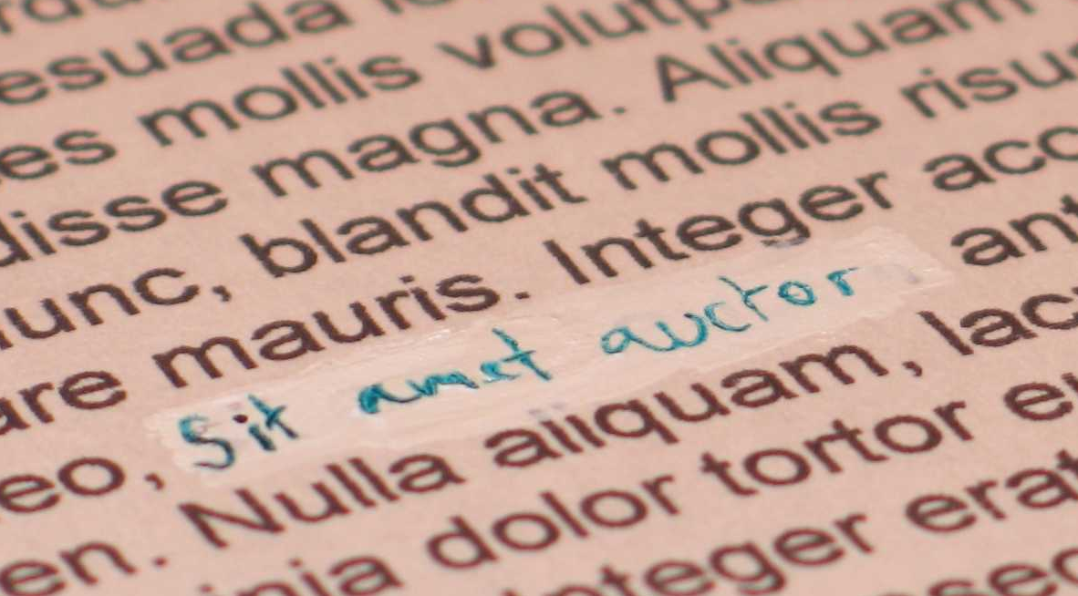
sub() function
You can use regex to substitute matched instances with a <string>
<regex variable>.sub(‘<substitute>’, ‘<text>’)

Slide 20
re Compile Options
The re module comes with several compile options which operate to the regex flags we discussed earlier.
re.VERBOSE :allows you to add Python comments to your regex statements.
re.IGNORECASE :makes the regular expression case insensitive
re.DOTALL :matches new line characters
Usually, the compile() function only takes one option but you can use | to pipe in multiple options
re.compile(<text>, re.VERBOSE | re.IGNORECASE)

